Slide 1








Metro User Group
Welcome!
Made possible by our Strategic Partners

Slide 2
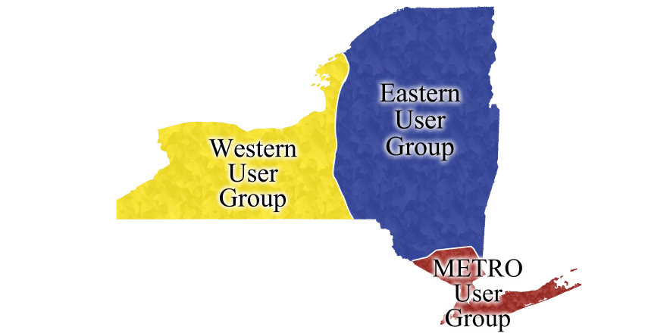
Metro User Group Libraries
Adelphi University
Baruch College
Bronx Community College
Brooklyn College
City College of New York
College of Optometry
College of Staten Island
CUNY Graduate Center
Downstate Medical Center
Fashion Institute of Technology
Hostos Community College
Hunter College
John Jay College
LaGuardia Community College
Lehman College
Manhattanville College
Maritime College
Molloy College
Nassau
New York Medical College
New York Public Library
Old Westbury
Purchase
Stony Brook Health Science Center
Stony Brook University
Suffolk
Special Guest: Orange County

Slide 3
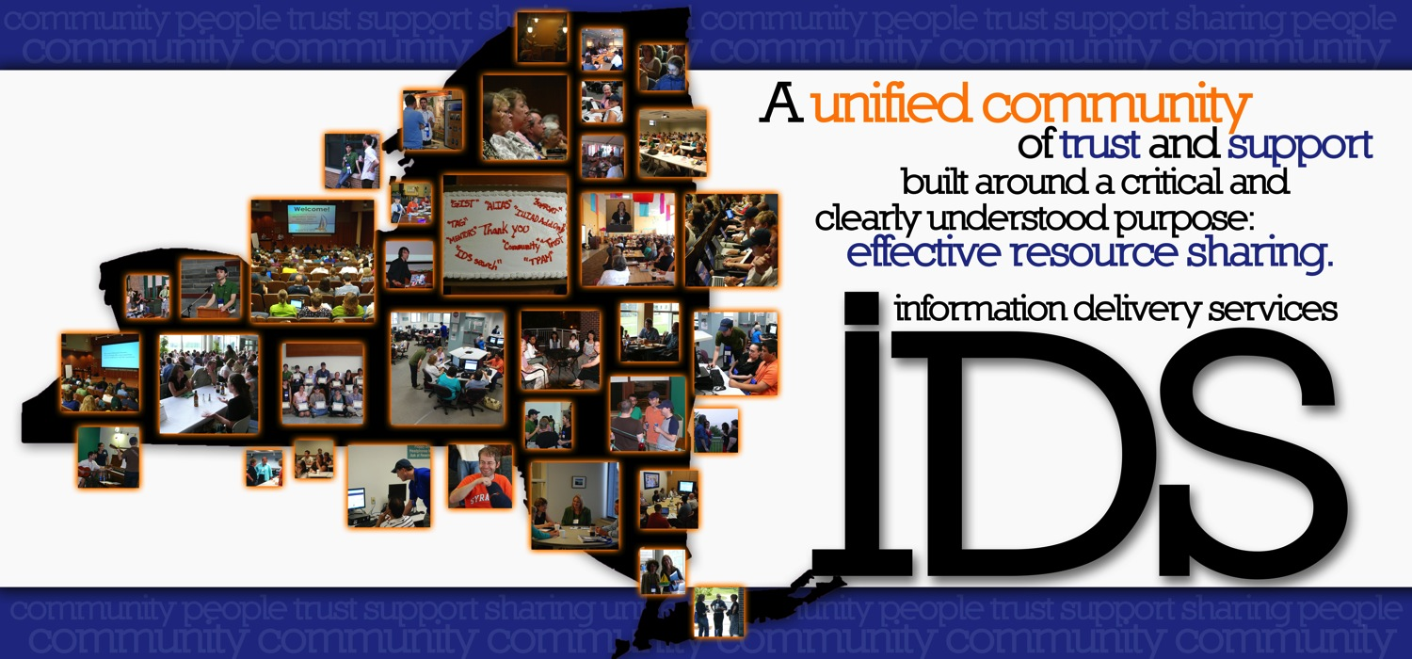
Welcome IDS Libraries
Promoting library excellence through community & technology

Slide 4

New IDS User Groups
Coordinator of IDS User Groups – Micquel Little
Coordinator of Mentors and Training – Chris Sisak
Chairs & Secretaries
Western Group
    Logan Rath – SUNY Brockport
    Lynne Marus – Nazareth College
Eastern Group
    Jennifer Acker – Hudson Valley Community College
    Karen Gardner-Athey - OLIS
Metro Group
    Beth Posner – CUNY Graduate Center
    Philip Mui – New York Public Library
Additional Mentors onsite and teleporting in
  Tim Bowersox and Andrew Leykam

Slide 5
A unified community of trust and support built around a critical and clearly understood purpose: effective
resource sharing

Slide 6
Goals
  Strengthen the community
  Promote collaborative learning and relationships
  Aid in the adoption of best practices for all areas of resource sharing
Notes:
We are starting out with three main goals to these User Groups:
To strengthen the community
To Promote collaborative learning and relationships
And to Aid in the adoption of best practices for all areas of resource sharing

Slide 7
Strengthen the Community
  Smaller groups
  Quarterly User Group meetings vs. once a year allowing for easier follow-up
  Support of your peers
Notes:
In his retirement announcement, Ed commented,
“The IDS Project is fundamentally not about technology--it is about human will and organizational change.”
With goal number 1, we’re aiming to strengthen the human component, the community.
First, by creating smaller groups. How many attended any of the Best Practices Workshop sessions at last summer’s conference? The room was huge, the crowds were large. We weren’t sure how many people we were reaching. And Large crowds tend to make some less apt to ask questions.
We saw a need for smaller groups, and to get the knowledge out to those smaller groups in a hands-on lab settings.
Second, we needed a more frequent and more convenient way to follow-up.
I think we’ve all experienced that “Oh, I can’t wait to get back to my library and implement this euphoria?” after a conference, only to have reality hit the first day back. And the project or idea gets set aside, and by the time you get back to it, you’ve forgotten what it was you were supposed to do, and there may be little to no support or follow up to get you back on track.
We set out for quarterly meetings – three times through out the year, and one meeting at the annual IDS Conference (in 2013).
This will allow for easy follow up with others from your group, and with the mentors.
And last, we’re aiming to strengthen the community through support of peers. These are your Groups, if you have successes share, if you have failures, share. By supporting each other we will strengthen the entire preoject.

Slide 8

  Promote collaborative learning and relationships
  Learning - User Group participation
      Make sure the group works for you
        Call for volunteers
      Presentation/publishing opportunities
      Professional development
      Work closely with mentors & peers
Notes:
Promote collaborative learning and relationships.
The second goal is to promote collaborative learning:
We’re looking for User Group Participation to:
Make sure the group works for you
What do you want to see from the IDS Project and from the Users Groups?
What topics? Or ideas do you have for enhancements, for anything resource sharing.
Throughout the day we’ll be asking for volunteers to help plan with the local Chair and Secretary, the next User Group and we hope that you consider.
Why volunteer? And what will you get out of it?
Add to your Curriculum vitae!
There are :
Presentation opportunities (such as you’ll see today)
You could facilitate a Group discussion
Have an idea for a chapter in the “Workflow Toolkit”? There are opportunities there.
And it’s an opportunity for advancing your Professional Development. You’ll learn something new about resource sharing every time.
You’ll also get a chance to work closely with the mentors and your peers to expand your knowledge of all things ILL, resource sharing, and what’s going on in the Project.
And you’ll always have fun!

Slide 9

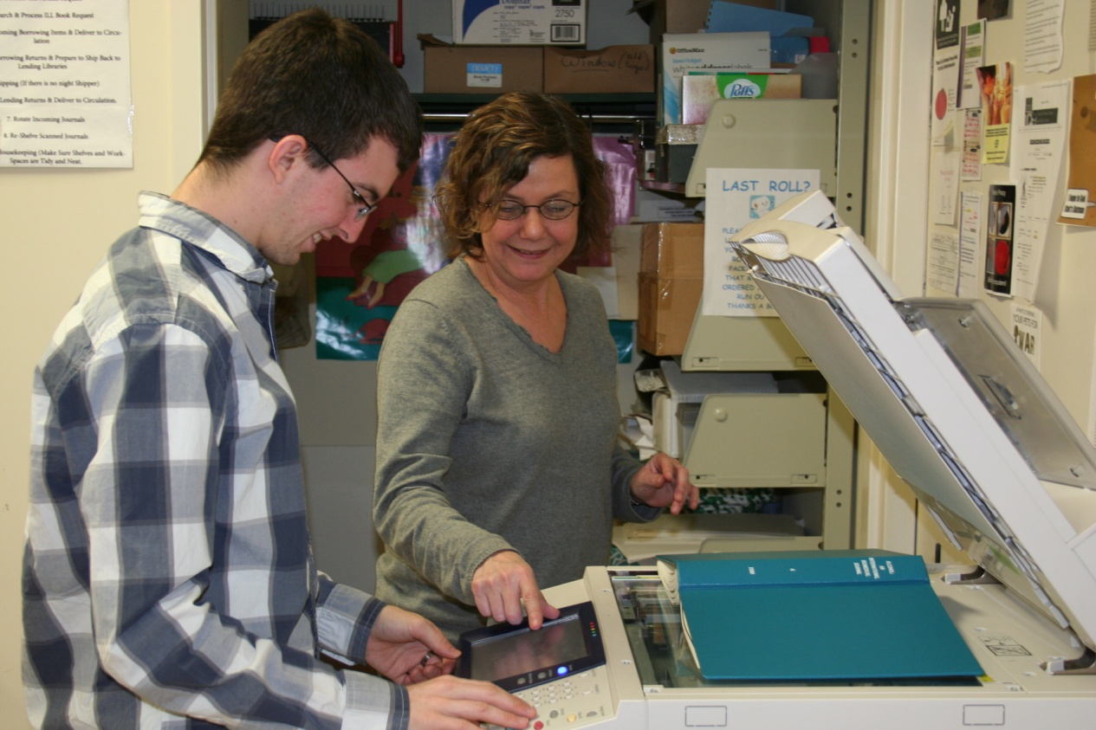
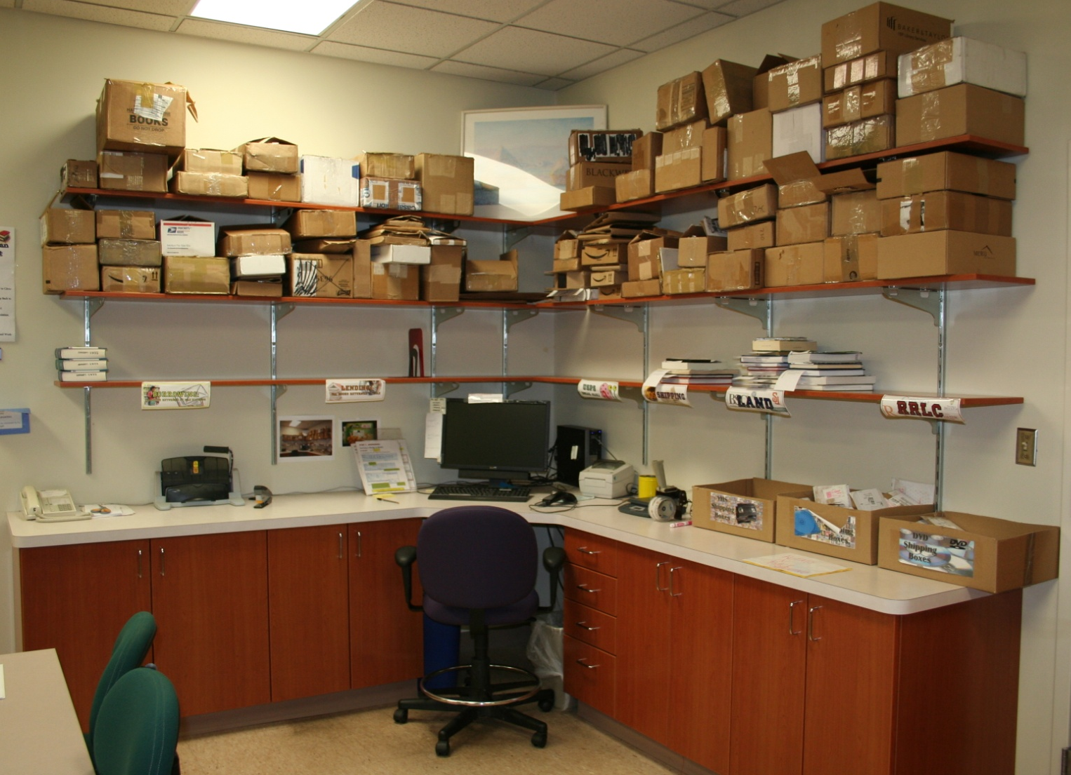
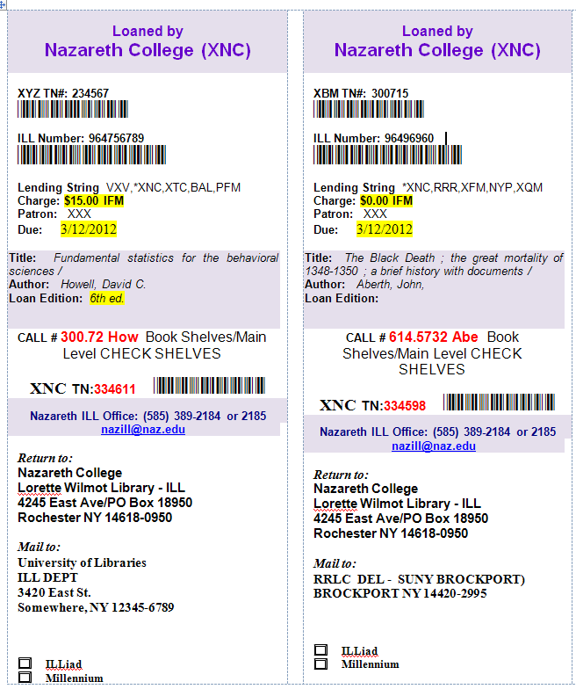
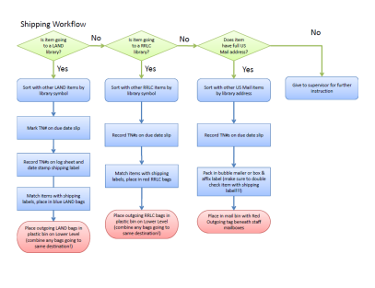
  Promote collaborative learning and relationships
  Building stronger relationships - An opportunity for everyone to learn
Partner up
Purpose of partnering up
  Get to know your fellow ILLers
  A visit!
    Virtual or in-person
  Check out their workflow
  Check out their office
  Emails, templates, packaging, and more!
Notes:
The other half of this goal is to promote collaborative relationships that will provide an opportunity for everyone to learn.
Each quarter we will have libraries partner up with each other and today at lunch and during break you’ll have the opportunity to choose your first library partner.
Doesn’t have to be the same size or type library as yours. Mix it up!
Some of you may be asking - Why am I partnering up?
It’s an opportunity to get to know your fellow ILL practitioners. To meet someone new!
You can plan a visit – either virtual or in person. Some of you may be thinking, “Oh gosh, I don’t want anyone to see the mess my office is!” Don’t panic! This is an opportunity for you to work with someone else, to get ideas off another library. Check out their workflow! Check out their Office!
Check out their Email templates, packaging, processing, training and more!
Ask yourselves, what might I “borrow? from their library? And you never know what they’ll borrow from your library.
It gives a whole new meaning to the philosophy “Your library is my library and my library is yours!”

Slide 10
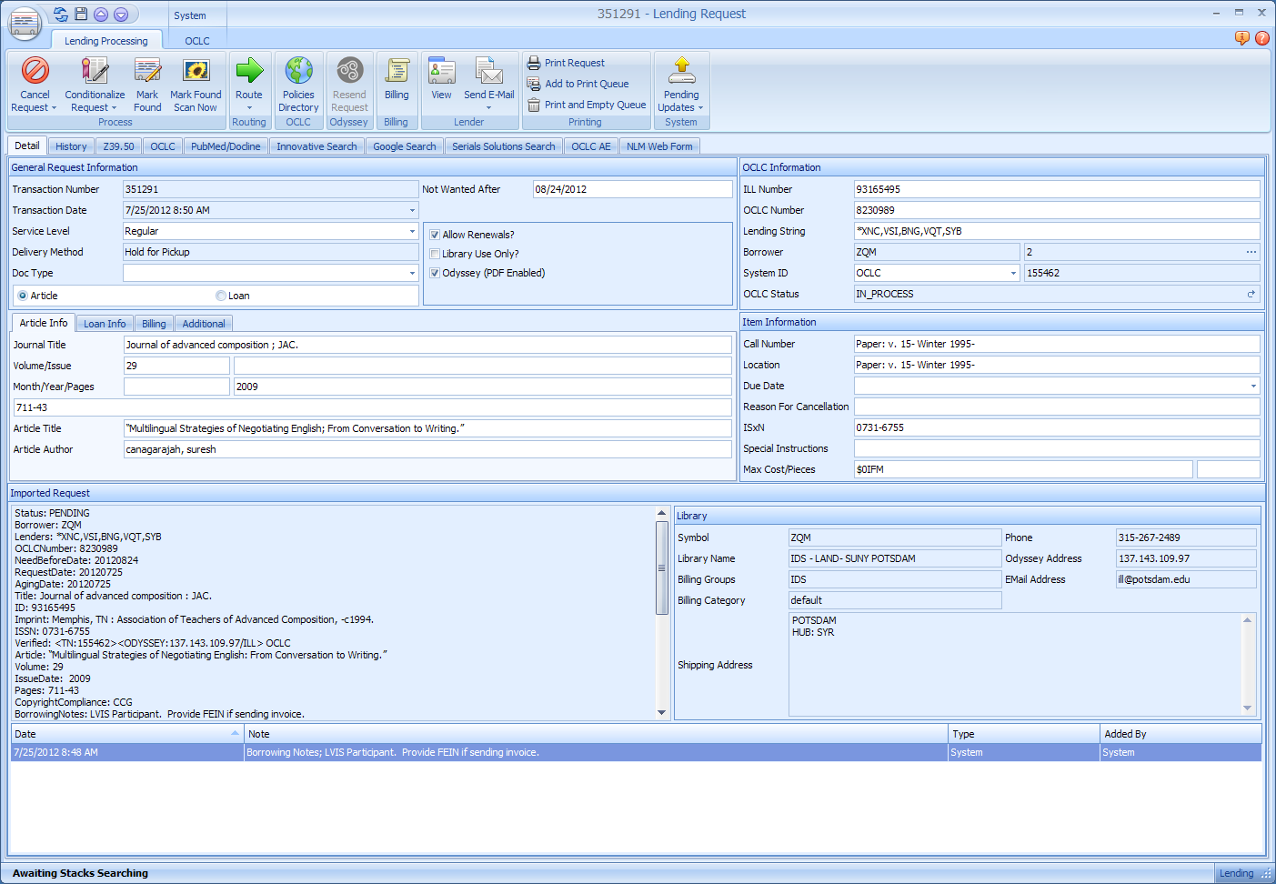
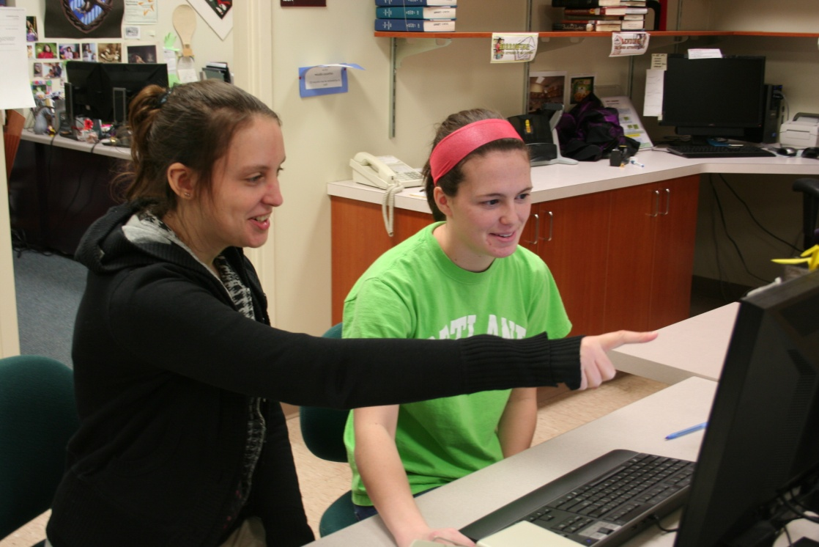
Top 10 things learned going out on visits!
Ability to use barcode scanner to input TN #s as file names
Space organization of where processing/shipping/etc. took place
Ideas for training student and staff (documents, videos, etc)
Ideas for customizing templates and cool short-cut emails
What’s that button do?
Notes:
As an example: This is a list of top ten things learned while going out on visits – and these are coming from the mentors while out on visits to libraries across the state.

Slide 11


Why do you have one of those buttons (fields), and we don’t?
Ability to key in file name to (some) scanners/copiers
Wait a minute… you can do what? How?
Ideas of Library Puzzles & Games
WOW! Your ILLiad has a great *new* color green! How’d you do THAT!? (Okay – not really! But when you view monitors from just the right angle…)
Notes:
6) For those up on 8.1 now, which should be everyone now, we have the ability to see this field on the Lending Article Screens. When this first changed, some of us couldn’t see it and weren’t aware it was even there until we visited another library.
Nine is an example of a non-resource sharing idea passed along on a visit. The idea of a library puzzle or games tossed out on a table for a de-stressing activity for students, staff and faculty alike!
Ten is a prime example of the things you discover while out on a visit. Someone has a beautiful green color for their ILLiad screens.
Ten is an example of the fun you can have when you’re out hosting another library.
In the back of the new Workflow Toolkit binder you will find a sheet entitled “Collaborative Technologies” as well as sheet to take with you on your physical or virtual visit that will help you get the most out of your time spent together. Please fill it out, bring it back to our next meeting. We want to hear what your thoughts were, what you learned.

Slide 12
  Aid in the adoption of best practices for all areas of resource sharing
    Traditional/ ILL
    Collaborative projects - POC
    Purchase on Demand/Collection Development
      GIST
    Technology
      IDS Search, Addons, Circulation Availability Service
    Knowledge & Ideas!
Notes:
And last on the list of goals for these User Groups, is to aid in the adoption of best practices for all areas of resource sharing.
Yes, we are talking about traditional resource sharing of materials and ILL. How do we move materials and documents swiftly from one institution to another’s customer seamlessly.
But we are also talking about resource sharing in terms of things like collaborative projects – the Proof of Concept is one example, using Regional Processing Centers to assist ILL operations in Libraries with Limited staffing resources
Also, purchase on demand models, collection development models, and programs such as GIST.
Technology and the sharing of technology expertise. IDS Search, Addon development, and Circulation Availability Service came through a sharing of technological knowledge between many people at various institutions.
And most of all, resource sharing our knowledge, expertise and ideas. These Users Groups are a conduit for you and your library to share your knowledge and ideas to strengthen all resource sharing.

Slide 13
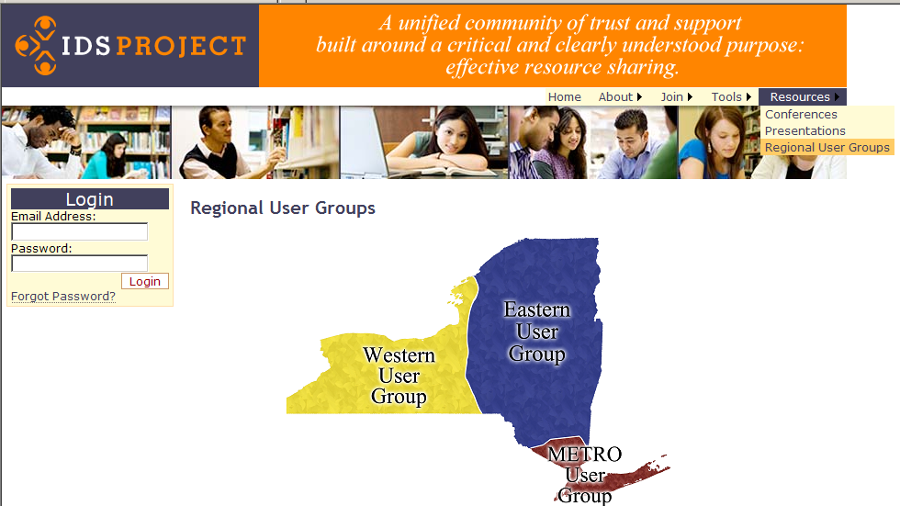
Communication
  IDS-L Listserv
  http://idsproject.org/usergroups.aspx
  Chair & Secretary
Notes:
Communication between quarters can take place via:
IDS-L listserv (if there is an interest in having regional listservs for those active in the groups, we can certainly look into those).
We also have a page on the IDS Project Website under Resources|Regional User Groups. This will have date, time, location, agenda, directions, maps and parking information listed. Please check it out.
We also have the names and contacts for the Chair and Secretary of your group.

Slide 14
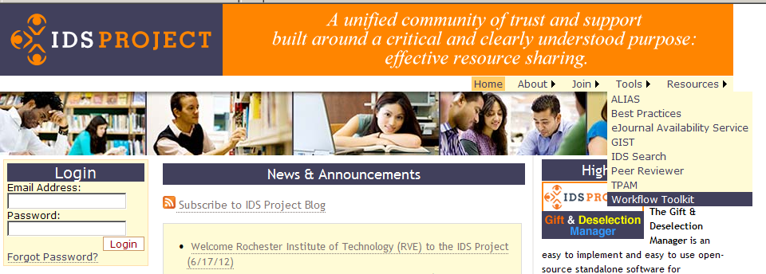
New Workflow Toolkit
  New Binder!
  http://toolkit.idsproject.org/
Notes:
New Binder
The Workflow Toolkit consists of individual Google Docs organized into sections, making it easy to use them online or print them out.
Broken down into:
Universal Best Practices
Borrowing Best Practices
Document Delivery Best Practices
Lending Best Practices

Slide 15
Email Share Board
A chance to share your template and pick up a new template or two.
*Note:
Templates will be loaded on the IDSProject.org website after the User Groups.

Slide 16
Questions? Comments? Volunteers?

Slide 17
Best Practices: Addons

Slide 18
Why Addons?
Addons make life easier by:
Removing the need to toggle between ILLiad and web browsers
Automating manual searching – no more copying, pasting, or typing titles!
Allowing flexibility for each ILLiad user’s client settings.
Providing e-journal license data to be integrated within your holdings!

Slide 19





Best Practices: Addons
A few of our favorite examples:
OCLC Article Exchange
CCC Get it Now
Serials Solutions
NLM form
Google

Slide 20
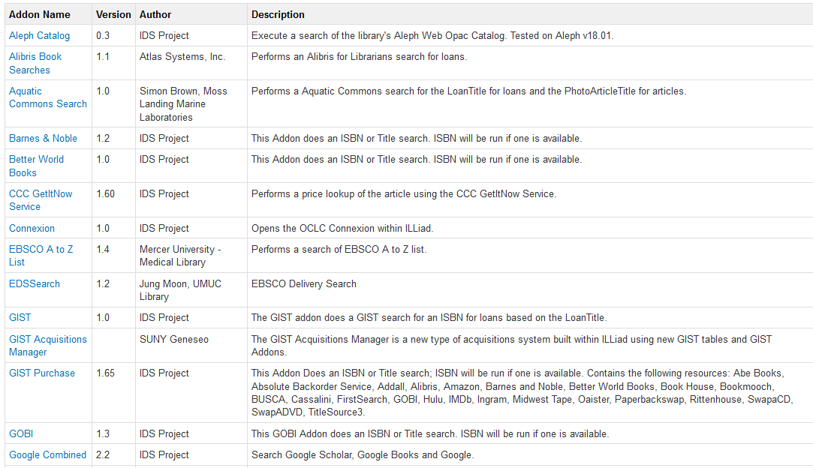
Best Practices: Addons
Getting started with Addons:
  Go to Atlas Systems Directory:
  https://prometheus.atlas-sys.com/display/ILLiadAddons/Addons+Directory
More info from Atlas and IDS: https://prometheus.atlas-sys.com and http://idsproject.org

Slide 21
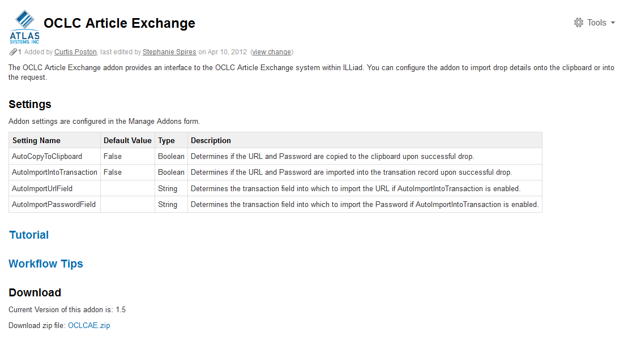
Best Practices: Addons
Choose an addon you’d like to implement:
Download the .zip file into your ILLiad/Addons folder and unzip the files
More info from Atlas and IDS: https://prometheus.atlas-sys.com and http://idsproject.org

Slide 22
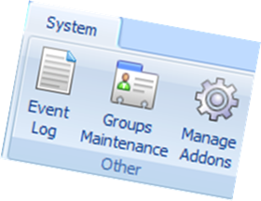
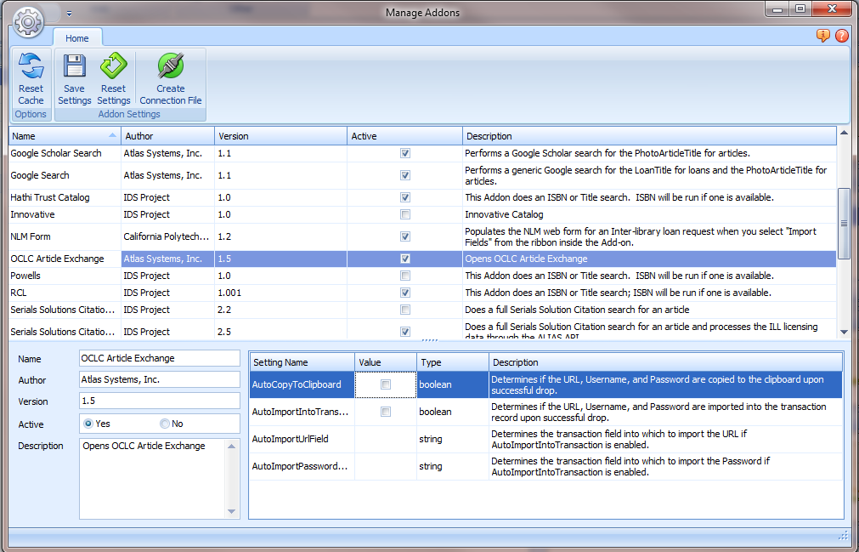
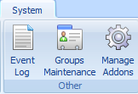
Best Practices: Addons
Set up Addon Settings in ILLiad:
Within the ILLiad Client, go to Manage Addons in the Settings tab and modify the Addon to the appropriate values

Slide 23
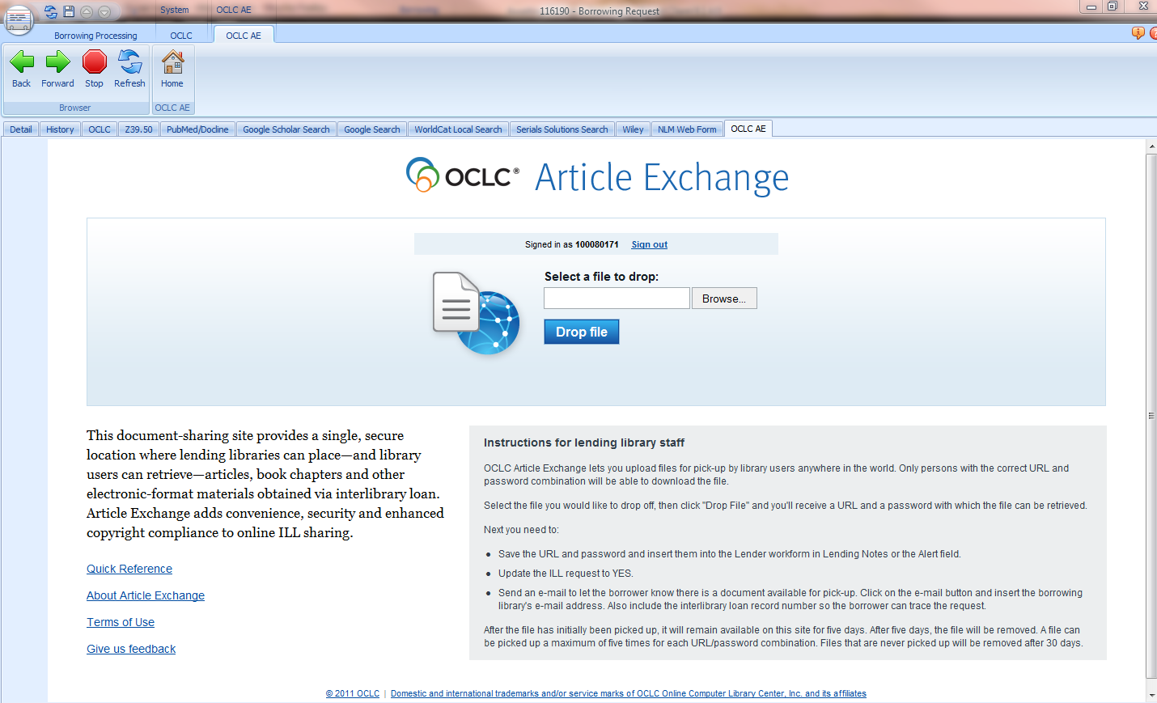
Best Practices: Addons
Your Addon is Ready!
More info from Atlas and IDS: https://prometheus.atlas-sys.com and http://idsproject.org

Slide 24
Let’s implement AE together!
Open a web browser
Google “Atlas Addon Directory”

Slide 25
Let’s implement AE together!
Scroll down to locate the OCLC Article Exchange Addon
Click on the link to open the OCLC Article Exchange page

Slide 26
Let’s implement AE together!
Scroll down to locate the OCLC Article Exchange Addon
Click on the link to open the OCLC Article Exchange page

Slide 27
Let’s implement AE together!
Click on the .zip link
Save to the desktop

Slide 28
Let’s implement AE together!
Export the files into your Addon folder – found here:
  C: drive
  Program Files (or Program Files x86 if you have it)
  Illiad
  Addons

Slide 29
Let’s implement AE together!
Open ILLiad
  Right click to open as administrator
  Login username: ids# use the number from your index card (i.e. ids03)
  Password: ids

Slide 30
Let’s implement AE together!
Click on Settings
Click on Manage Addons
Highlight OCLC AE addon to input Values

Slide 31
Let’s implement AE together!
  AutoCopyToClipboard – check box
  AutoImportToTransaction – check box
  AutoImportURLField – CallNumber
  AutoImportPasswordField - Location
  Click Save
  Click Reset Cache

Slide 32
Let’s implement AE together!
You did it!
Questions?

Slide 33
OCLC Article Exchange

Slide 34
What is OCLC Article Exchange?
Dropbox service
  Lending libraries place articles or book chapters in the dropbox
    A unique URL and password are created
    The URL and password are sent to the borrower
  Borrowing libraries use the URL and password to retrieve articles or book chapters requested via interlibrary loan

Slide 35
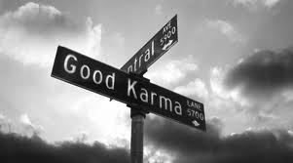
Remember Your ILL Karma
Important – Article Exchange is intended as a method to deliver articles and book chapters to libraries who do not have Odyssey.
  “Odyssey unto others as you would have them Odyssey unto you.”

Slide 36
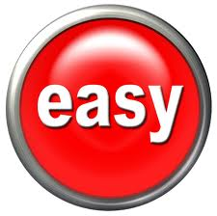
Why Should I Use OCLC’s Article Exchange?
More secure than email
Supports copyright compliance
  Files are deleted after 5 views or 30 days if unviewed
For ILLiad users…
  There’s an addon!

Slide 37
Three Easy Steps to Implementation
Install the OCLC Article Exchange Addon.
Create an Email Routing to notify libraries that their document is available for download.
Create a Routing Rule that avoids printing Shipping Labels.

Slide 38
1. The Article Exchange Addon
Allows you to share documents without leaving the ILLiad client.
https://prometheus.atlas-sys.com/display/ILLiadAddons/OCLC+Article+Exchange

Slide 39
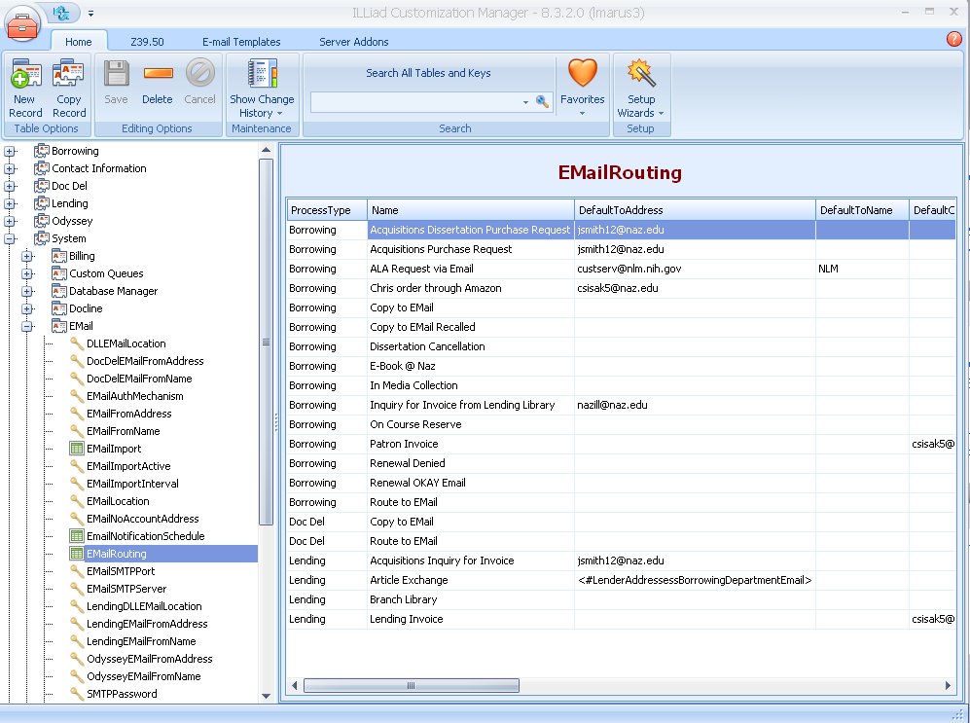
2. Email Routing
Notifies borrowing library that their document is available for download.

Slide 40
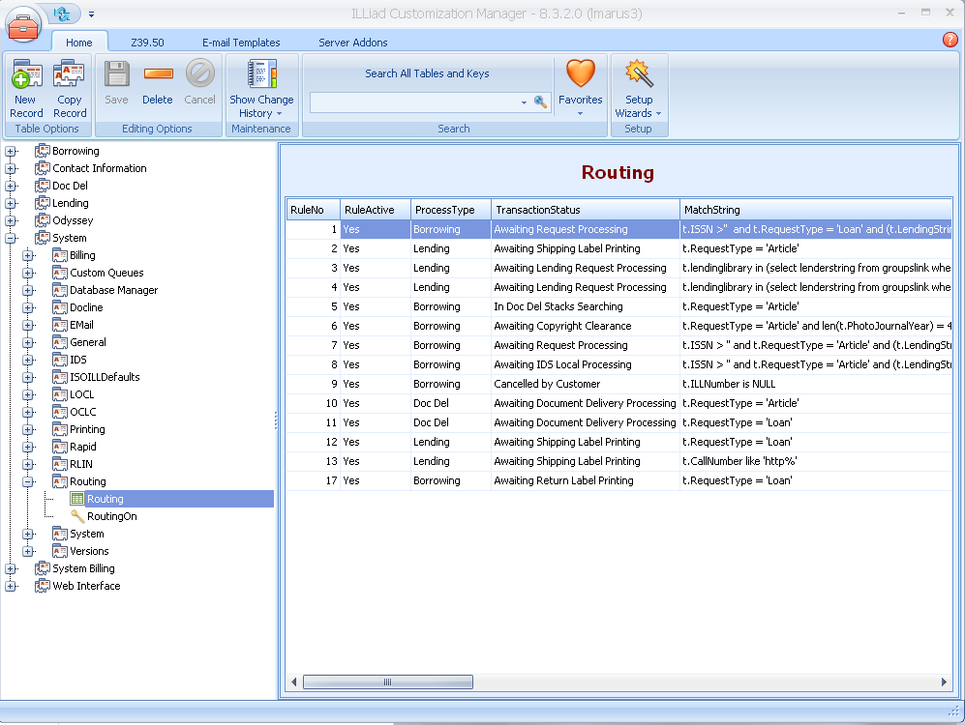

3. Routing Rule
Keep it Green! Avoid printing pull slips. Requests are automatically routed to “Request Finished” status.

Slide 41

ILLiad Tutorial
ILLiad 8.2 Article Exchange Workflow Tutorial by Atlas

Slide 42
Give it a Try!
Hands-on Demonstration

Slide 43
Troubleshooting Print Templates
IDS User Groups
July/August 2012
Notes:
Ask those for show of hands:
Those who have converted?
Those who haven’t?
Those who aren’t sure?

Slide 44
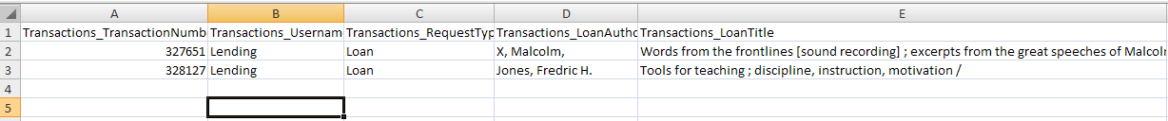
Old verses New
ILLiad 8.0-8.0.12
ILLiad 8.1+
.dbf files
File Names
(BorrowingLoanSlips)
  TRANSACTIO
(LendingArticleSlips)
  PHOTOJOU_4
.xls files
File Names
(BorrowingLoanSlips)
  Transactions_TransactionNumber
(LendingArticleSlips)
  Transactions_PhotoJournalYear
Notes:
What’s the difference between the two?
The old ones run off .dbf files
The new templates spawn off .xls files
The old ones have mysterious field names such as Transactio and PhotoJou_4
The new field names make more sense Transactions table so Transactions_TransactionNumber or PhotoJournalYear as noted in the second example

Slide 45
Why Change?
Confusion?
Less Confusion
«PHOTOJOU_1»
«PHOTOJOU_2»
«PHOTOARTIC»
«ADDRESS1»
«Transactions_PhotoJournalVolume»
«Transactions_PhotoJournalIssue»
«Transactions_PhotoArticleAuthor»
«LenderAddresses_Address1»
Notes:
Why change?
First off, the newer template field names are a lot less confusing.
Anyone want to venture what this stands for?

Slide 46
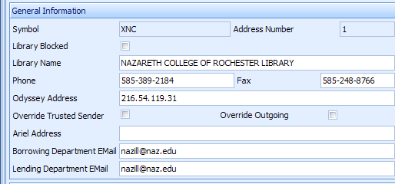
Why change?
  Lending Library Email field comes back!
  «
«EMAILADDRE» now split into
«LenderAddresses_BorrowingDeptEmail»
«LenderAddresses_LendingDeptEmail»
Notes:
Another reason is the Lending Library email field comes back.
In 8.1 ILLiad, the email addresses were split into two: one for borrowing departments and one for lending.
If you haven’t changed you may have had troubles with bringing up slips that had the Lending Library email address in them.
Or what was called the “EmailAddre”
You may have just deleted the field to bypass the trouble, but now you might find yourself looking up email addresses.

Slide 47
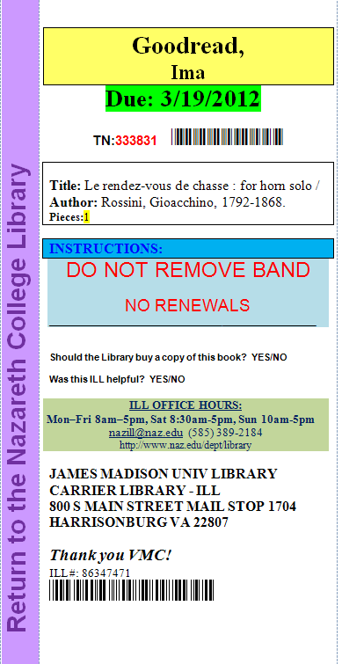
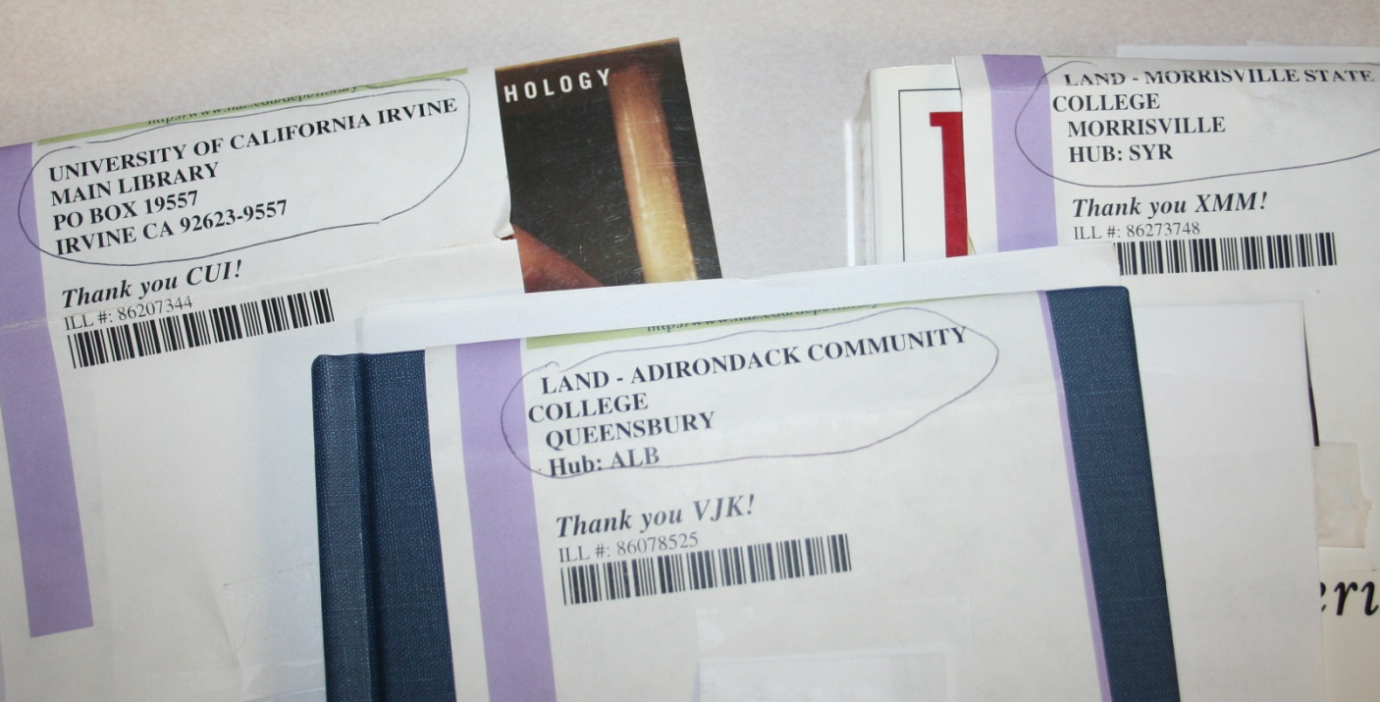
Why Change?
Greater Flexibility
  Info from Lending table can be imported into Borrowing templates.
Notes:
The biggest reason is the Greater Flexibility these offer.
Not only do you get your email addresses to show up, but the ability to import info from the Lending table into borrowing templates can be done.
This is an example of a book strap at Naz. It doubles as a return ticket to the lending libraries because we can now import the return address right on the borrowing template.

Slide 48
Getting Started
Find your templates
  Customization Manager: System|General|PrintDocumentsPath
NOTE: Having your Print templates in a networked folder is highly recommended.
Backup your templates
Designate one to work on
Rename the original in the Print folder
Copy/paste your customized original into the Print folder
Open your customized Template
Notes:
When you get home, be sure to use the Print Templates section found in the Workflow Toolkit binder
Here are just a few reminders

Slide 49
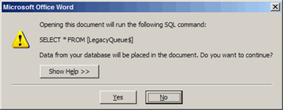
LegacyQueue$ versus PrintQueue$
If you receive the message below, please note that the newer templates run on “PrintQueue$” not “LegacyQueue$”.
Answer ‘No’.
[Your print template should open].
Notes:
Now, when you open up your old templates, be sure you click “no” when you get to this part.
Has anyone clicked ‘yes’?

Slide 50
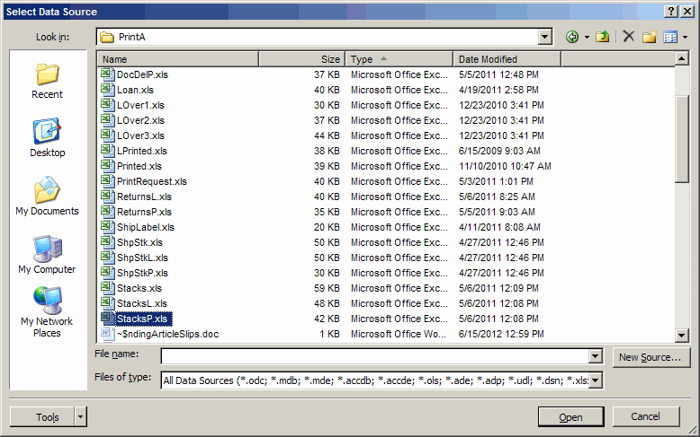
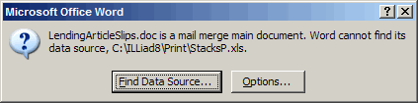
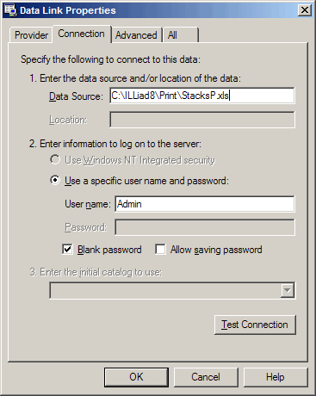
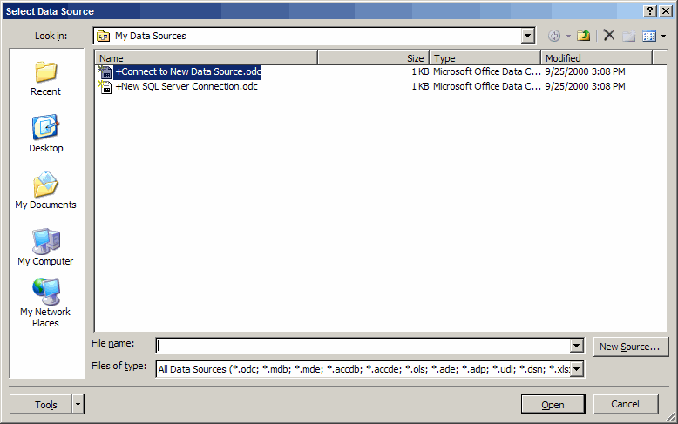
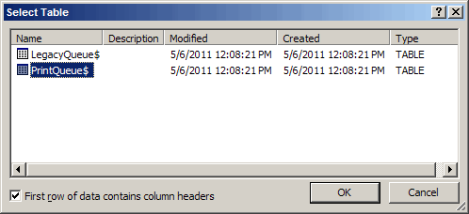
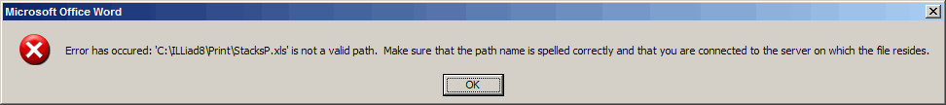
Answered yes?
Notes:
You get this message. And then if you figure out to do then you get this one, and the next one and then next….
And it turns into a flash back of those bad links we’ve all ventured on one time or another where you’re computer it over run with spamming pictures and ads!

Slide 51
Remember, just say ‘No’
Answer ‘No’.
[Your print template should open].

Slide 52
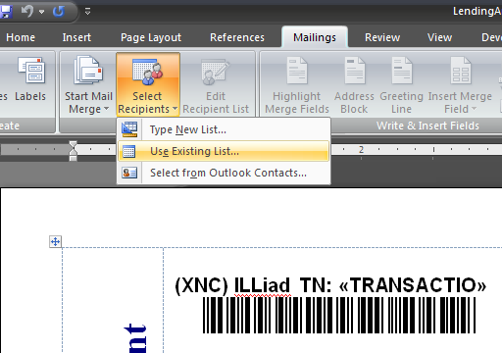
In Word click on the Mailings tab
Locate the Select Recipients|Use Existing List

Slide 53
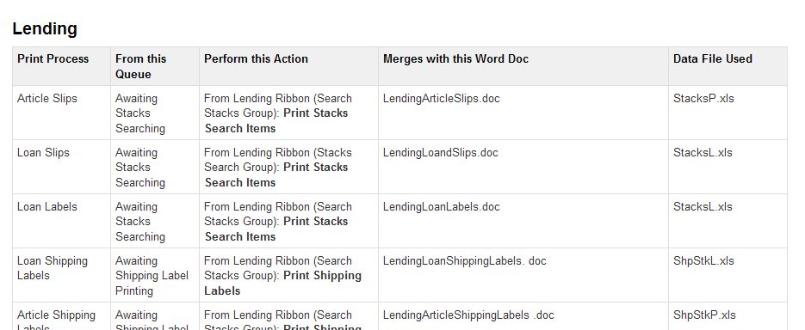
Now you will be locating and matching the corresponding Data File (or .xls file) to the Word template. Please refer to the Atlas link for matching templates with Data Files:
https://prometheus.atlas-sys.com/display/illiad/Customizing+Printer+Templates
Or Google - “ILLiad Print Templates”
Notes:
It’s a hot Google link! You’ll also find YouTube videos on how to edit your templates brought to you by the Western NY Resources Council and the University at Buffalo

Slide 54

Navigate to the corresponding file located in your C:\Program Files\ILLiad\Print folder (on 64-bit machines, it’s C:\Program Files (x86)\ILLiad\Print). The corresponding file for LendingArticleSlips is StacksP.xls

Slide 55

Now, select PrintQueue$ and click OK

Slide 56
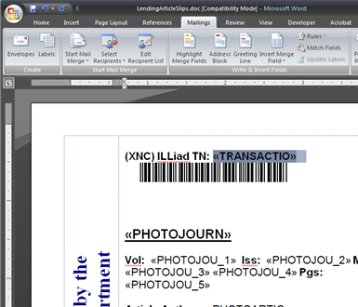
Your template will come up with the old LegacyQueue$ data (ex. <<Transactio>> )
Begin changing the fields by:
  Highlighting an old field name.

Slide 57
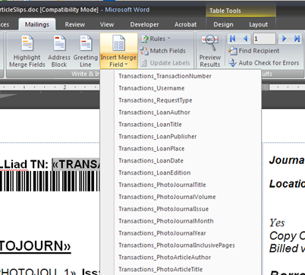
Select Insert Merge Field and select the corresponding field name. In this case Transactions_TransactionNumber
Save after you’ve finished renaming all of the fields.

Slide 58
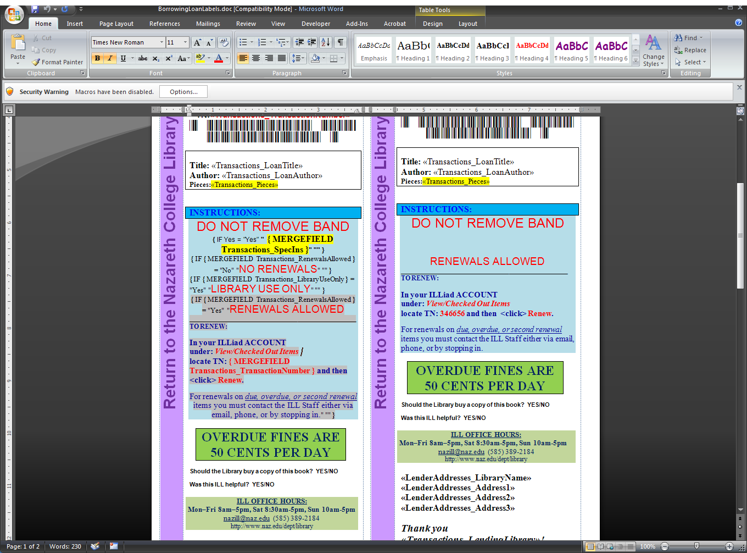
Don’t forget:
Hidden Toggle Codes - If you have toggle codes (“if” and “then” merge fields), highlight the area where they reside and <right click> and select <Toggle Field Codes> to reveal the codes needing to be changed.
Notes:
If you’re having a “how did you do that” moment – make a note, ask when we try this!

Slide 59
A Reminder:
Getting your Barcodes to Print – In plain text, your barcodes should read:
*«Transactions_TransactionNumber»*
Now, convert that entire string to the 3 of 9 barcode font.
TN:«Transactions_TransactionNumber» *319521*

Slide 60
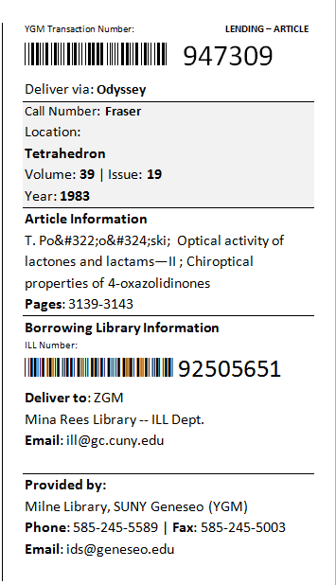
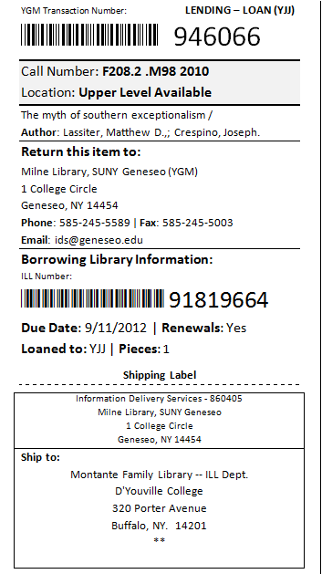
Sample Print Templates
Notes:
The online version of the Workflow Toolkit has a number of templates available for download. Check them out.

Slide 61
Ready?
Notes:
Windows have been locked and we’re here to help!

Slide 62
Get it done with 8.1!
(And 8.2 & 8.3!)

Slide 63
ILLiad 8.1

Slide 64
Summary
First server and database changes since 7.4
Odyssey supports PDF transmission
Print templates use new data sources
New database fields & tables
  Lender addresses have Lending & Borrowing emails
  Lender addresses have real Notes now!
Supports IDS Circulation Availability Service
Supports new version of GIST for ILLiad
Empty Odyssey Helper backup folder

Slide 65
ILLiad 8.2

Slide 66
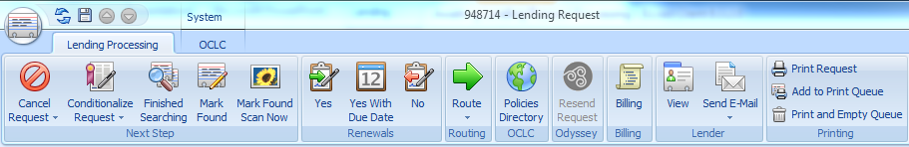
Summary
“Mark Found” & “Mark Found Scan Now” baked into Lending & Doc Del requests
Allows you to easily deliver e-journal articles on the fly – no more Update Stacks Search!

Slide 67
Lending Examples
Odyssey
Non-Odyssey
Save the PDF (TN.pdf)
Click Mark Found Scan Now
When Odyssey appears, click Deliver
Save the PDF (TN.pdf)
Deliver via Email Routing or Article Exchange
Click Mark Found
No More…
Printing (or avoiding printing) pull slips
Update Stacks Search Results
Arduous updating for non-Odyssey articles

Slide 68
Summary
Supports new OCLC Constant Data addresses
Supports OCLC Alerts
Added PMID and DOI fields to Transactions table

Slide 69
ILLiad 8.3

Slide 70
Summary
Fully unicode compliant! Now displays non-Western characters instead of nonsense!
Automated overdue notices!
Addons can use NCIP for seamless circulation workflow
Send Email now available option when viewing a queue
Print user and lender address records
New format for request notes (text area)
Mobile webpage CSS

Slide 71
Summary
Server Addons allow advanced routing and workflow options
  Run on the server, created in the Customization Manager
  Route requests (beats compound routing rules)
  Add notes
  Send emails
  Flag requests
  Update OCLC records
  Save transactions

Slide 72
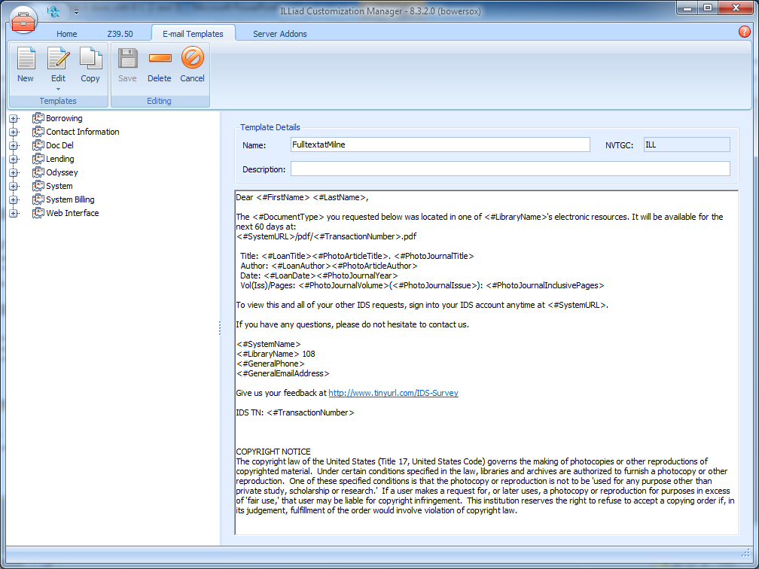
Summary
Email templates can be shared via Customization Manager

Slide 73
Summary
“Logon to Web” feature allows you to navigate a user’s web interface
  You can see what they see
  Perfect for guiding patrons through their accounts over the phone

Slide 74
http://prometheus.atlas-sys.com
You can view all of the release notes at:

